Slide 1


COM3123 - Lecture 7
Intro to Angular & TypeScript

Slide 2
Topics
SPA vs MPA
Angular Introduction
Typescript Introduction

Slide 3
Types of Web Applications
The inception of web introduced hypertext documents but those were replaced by the sophisticated and feature-rich web apps. The current web application development scene can be divided into two approaches. They are:
Multi Page Application
Single Page Application

Slide 4
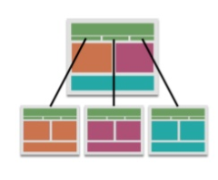

MPA - Multi Page Application
Multi page applications are the traditional web applications that reload the entire page and displays the new one when a user interacts with the web app.
It takes time to generate the pages on the server and send to client, which may affect the user experience.
However, AJAX has made the made this faster, it is also difficult to develop.
Built with PHP, ASP, Ruby and Python

Slide 5
MPA - Multi Page Applications
Benefits
Performs well in SEO (Search Engine Optimization)
Provides a visual map of application to user
Disadvantages
Complex Development
Coupled Backend and Frontend

Slide 6
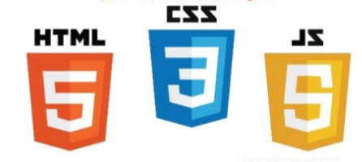

SPA - Single Page Application
A next evolution from traditional website
Web apps that load in a single HTML page
SPAs use AJAX and HTML5 to create fluid and responsive Web apps, without the constant page reloads
Used in Twitter, Facebook and GMail etc.
Built with Javascript Frameworks

Slide 7
SPA - Single Page Applications
Benefits
SPA are smooth and fast.
Easy to develop and deploy.
Easier to debug.
Can be transited to mobile apps by reusing the same backend code.
Disadvantages
Poor SEO performance
Single page applications provide single sharing link.
They are less secure compared to traditional because of cross-site scripting

Slide 8
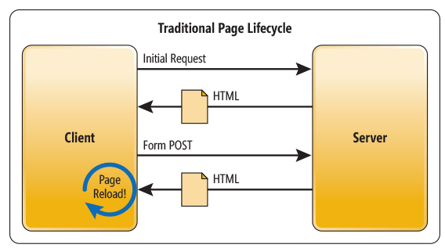
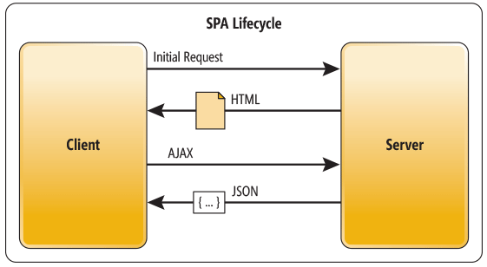
MPA vs SPA Lifecycle

Slide 9
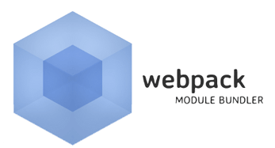
What is Webpack?
Webpack is a popular module bundler, a tool for bundling application source code in convenient chunks and for loading that code from a server into a browser.
A bundle is a JavaScript file that incorporates assets that belong together and should be served in a single file request.
A bundle can include JavaScript, CSS styles, HTML, and almost any other kind of file

Slide 10
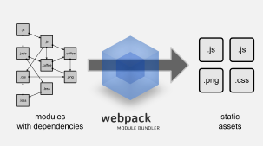
Webpack cont..
Webpack roams over your application source code, looking for import statements, building a dependency graph, and emitting one or more bundles.
With plugins and rules, Webpack can preprocess and minify different non-JavaScript files such as TypeScript, SASS, and LESS files.

Slide 11
Angular is..
A JavaScript framework for building Client-side applications using HTML, CSS and JavaScript

Slide 12
Why Angular?
Expressive HTML
it powers up html with if conditions, for loops and local variables
Powerful data-binding
we can easily display fields from our data model, track changes and process updates from user
Modularity by Design
our application because a set of building blocks, making it easier to create and re-use content
Built-in Back-End Integration
this makes it easy to integrate with backend service

Slide 13
Why a New Angular?
Built for Speed
Faster initial loads, faster change detections and improved rendering times.
Modern
It takes advantages the latest JavaScript ES7 features such as classes, modules and decorators
Simplified API
It has fewer built-in directives to learn, simpler bindings and lower concept cout
Enhances Productivity

Slide 14
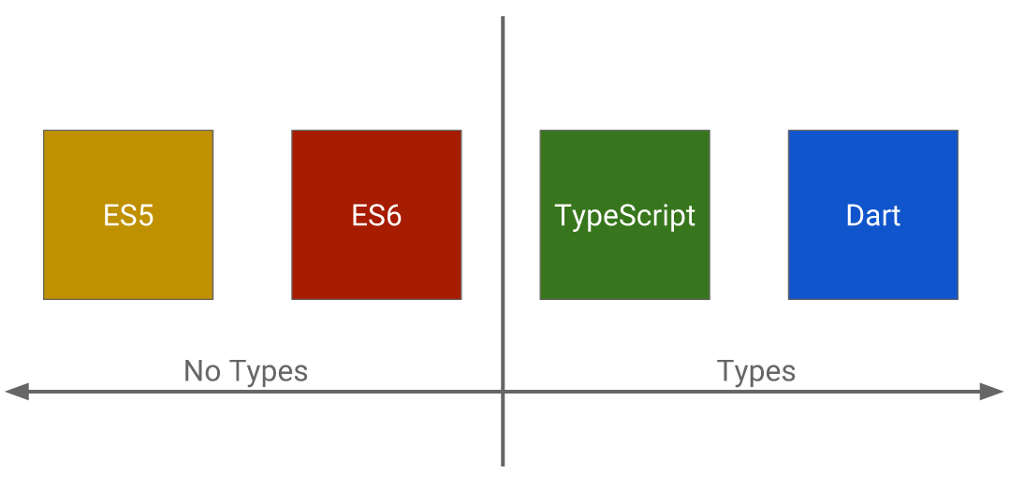
Language support for Angular 2
Advantages of languages with type support
Interfaces and Types
Helps detect error when we type
Helps give us hints

Slide 15
What is TypeScript ?
Is a typed superset of JavaScript
It’s JavaScript, but built for more scale
TypeScript compiles to plain old JS
Any browser. Any host. Any OS
Open source programming language developed and maintained by Microsoft
https://www.typescriptlang.org

Slide 16
JavaScript
The Good
It’s everywhere
Huge amount of libraries
Flexible
The Bad
Dynamic typing
Lack of modularity
Complex patterns
In short: JavaScript development scales badly.

Slide 17
Why use TypeScript ?
Modular code
Easily learnable for Java or C# developers
Clean Js output
Strongly static typing
We want maintainable code and easy to work with!

Slide 18
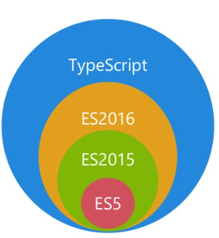
TypeScript is a superset of JavaScript
TypeScript extends an d adds features to JavaScript similar to Node.Js
* ECMAScript has now changed to year extension to track version releases ie. ES2016, ES2017

Slide 19



What are the Alternatives?
Several alternatives to TypeScript
Write pure JavaScript
Apply JavaScript patterns
CoffeeScript - http://coffeescript.org
Dart - http://dartlang.org

Slide 20
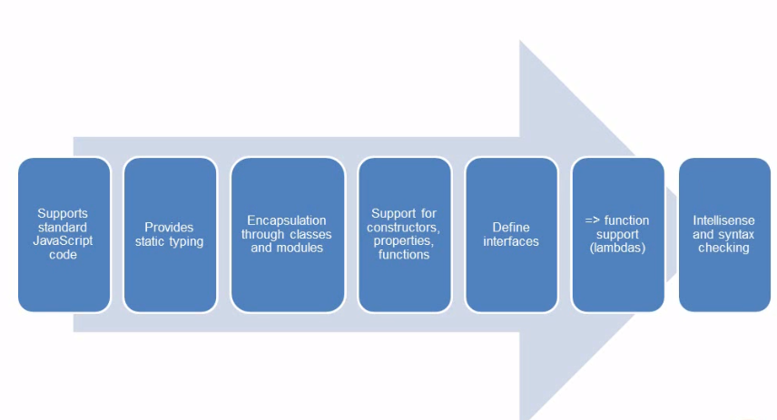
Key TypeScript Features

Slide 21
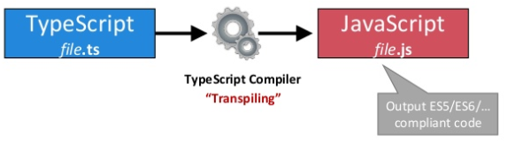
How does TypeScript work?
Download the TypeScript compiler via NPM

Slide 22
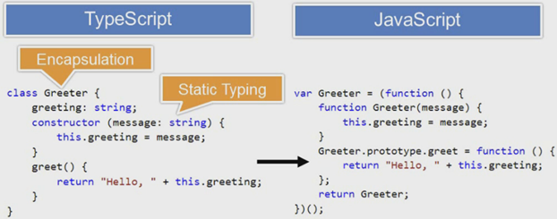
TypeScript transpiled to JavaScript

Slide 23
TypeScript Types https://www.typescriptlang.org/docs/handbook/basic-types.html
Core types (optional but very helpful):
string
number
boolean
Date
Array
any
Custom types

Slide 24
TypeScript Type Annotations
name: string;
age: number;
isEnabled: boolean;
pets: string[];
accessories: string | string [];

Slide 25
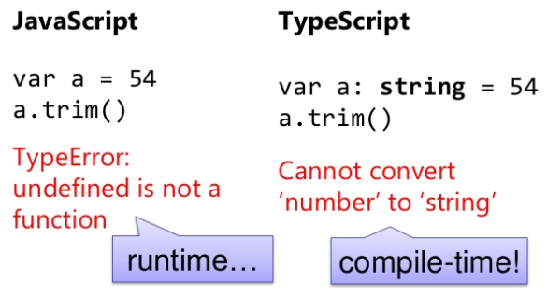
Why use Types?
Errors at compile-time!

Slide 26
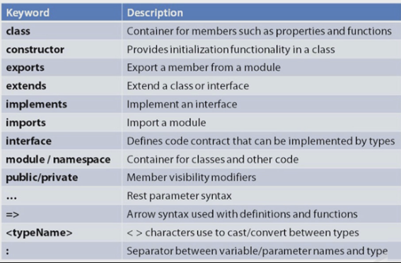
Reserved keywords in TypeScript

Slide 27
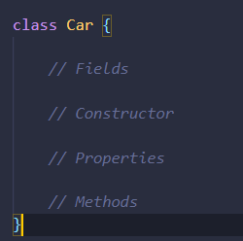
Defining a Class
Classes act as containers to encapsulate code https://www.typescriptlang.org/docs/handbook/classes.html

Slide 28
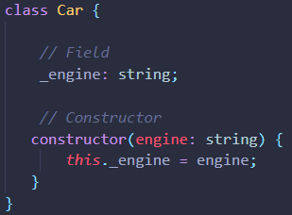

Defining a Constructor
Constructors are used to initialize fields

Slide 29
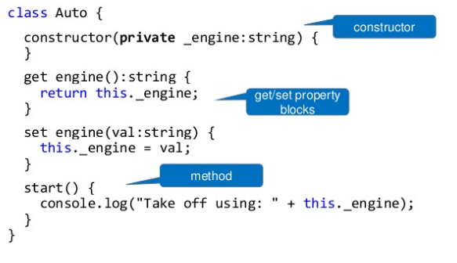
Class, Constructor and public/private properties

Slide 30
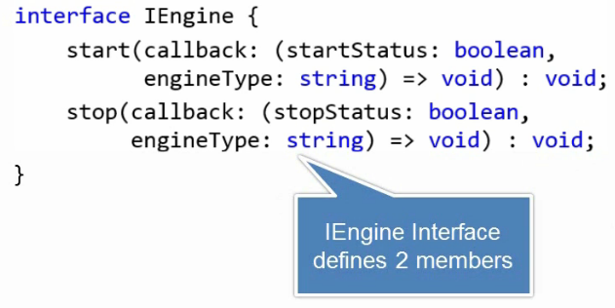
Defining an Interface
Interfaces provide a way to define a "contract" that other objects must implement https://www.typescriptlang.org/docs/handbook/interfaces.html

Slide 31
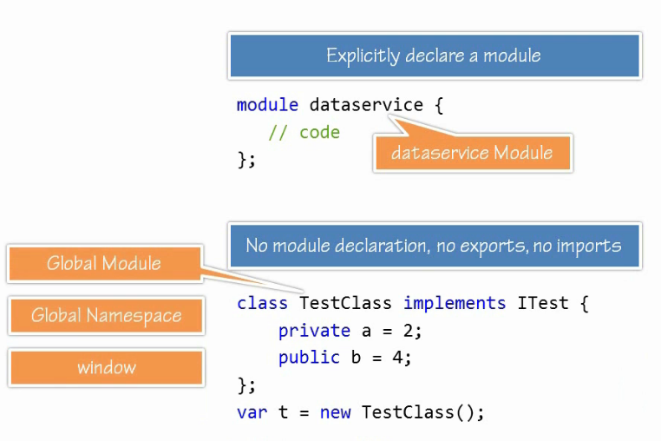
Defining a Module
Modules are executed within their own scope, not in the global scope; this means that variables, functions, classes, etc. declared in a module are not visible outside the module unless they are explicitly exported. https://www.typescriptlang.org/docs/handbook/modules.html

